Slide 1
TECHNICAL PROJECT PRESENTATION
Adaptive Hybrid
Attention–SSM–Convolution
Language-Model Prototype
Technology selection • Architecture • Implementation • Results

Slide 2
Project Overview
Research question and current scope
Research question
Current objective
Implementation boundary
Can global attention, sequential state-space processing, and local convolution complement each other through adaptive fusion?
Validate an end-to-end language-model training pipeline on public text and establish a measured baseline.
The SSM branch is a feed-forward placeholder, not real Mamba.
• Dataset: WikiText-2 raw
• Tokenizer: byte-level BPE, vocabulary 10,000
• Configuration: dimension 128, four blocks, four attention heads
2

Slide 3
Objectives and Scope
Completed work versus future work
Completed
Next stage
• Public dataset downloaded and preprocessed
• Tokenizer trained on training split only
• Hybrid prototype implemented
• Five epochs completed and test split evaluated
• Integrate a genuine selective SSM
• Add and verify positional information
• Run controlled ablations and fair baselines
• Measure throughput, memory, and repeatability
3

Slide 4
a. Technology Selection
Why each mechanism is included
Self-attention
State-space model
Depthwise Conv1D
Content-dependent relationships across token positions. Current implementation: PyTorch MultiheadAttention.
Target design: efficient sequence processing. Current implementation: temporary Linear–SiLU–Linear placeholder.
Extracts local temporal patterns using a small convolution kernel; current kernel size is 3.
Adaptive fusion predicts three token-dependent weights and mixes the branch outputs.
4

Slide 5
b. Tools and Platforms
Software stack and responsibilities
PyTorch
Hugging Face Datasets
Tokenizers
Neural-network modules, autograd, optimizer, loss and checkpoints
Loads Salesforce/wikitext, configuration wikitext-2-raw-v1
Trains and saves byte-level BPE tokenizer
Python + VS Code
Matplotlib + CSV
PyTorch checkpoint
Implementation, configuration, testing, virtual environment
Loss curve and per-epoch training history
Saves the best model selected by validation loss
5

Slide 6
Dataset and Data Collection
Public source and actual preprocessing statistics
Dataset
Tokenizer
WikiText-2 raw • Salesforce/wikitext
wikitext-2-raw-v1
huggingface.co/datasets/Salesforce/wikitext
Byte-level BPE trained on training text only
Vocabulary: 10,000
Special tokens: <pad>, <unk>, <eos>
Split | Non-empty lines | Token IDs | Sequences
Train | 23,767 | 2,614,959 | 20,271
Validation | 2,461 | 276,447 | 2,143
Test | 2,891 | 316,437 | 2,453
6

Slide 7
Data Preprocessing Pipeline
Split discipline and sequence construction
1. Load
2. Filter
3. Train tokenizer
Load official train/validation/test splits
Remove blank lines
Fit BPE on training text only
4. Encode
5. Chunk
6. Save
Tokenize each split and add EOS markers
Create 129-token blocks
Store tensors, tokenizer, metadata
128 input positions + shifted targets; stored sequence width = 129 tokens
7

Slide 8
c. Technology Comparison
Strengths, limitations, and project role
Mechanism | Strength | Limitation | Role
Attention | Global content-dependent interaction | Quadratic full-attention interaction cost | Global context
Selective SSM | Efficient sequential processing | Specialized build; not yet integrated | Planned sequence path
Depthwise Conv1D | Low-cost local features | Small receptive field | Local patterns
Adaptive fusion | Input-dependent mixing | Does not skip branch computation | Combines outputs
8

Slide 9
Adaptive Three-Way Fusion
Central design idea
g = softmax(MLP(Xₙ))
H = gₐA + gₛS + g𝚌C
Attention output A
SSM placeholder S
Convolution output C
Global, content-dependent context
Temporary feed-forward branch
Local sequence features
Softmax weights are non-negative and sum to one per token.
9

Slide 10
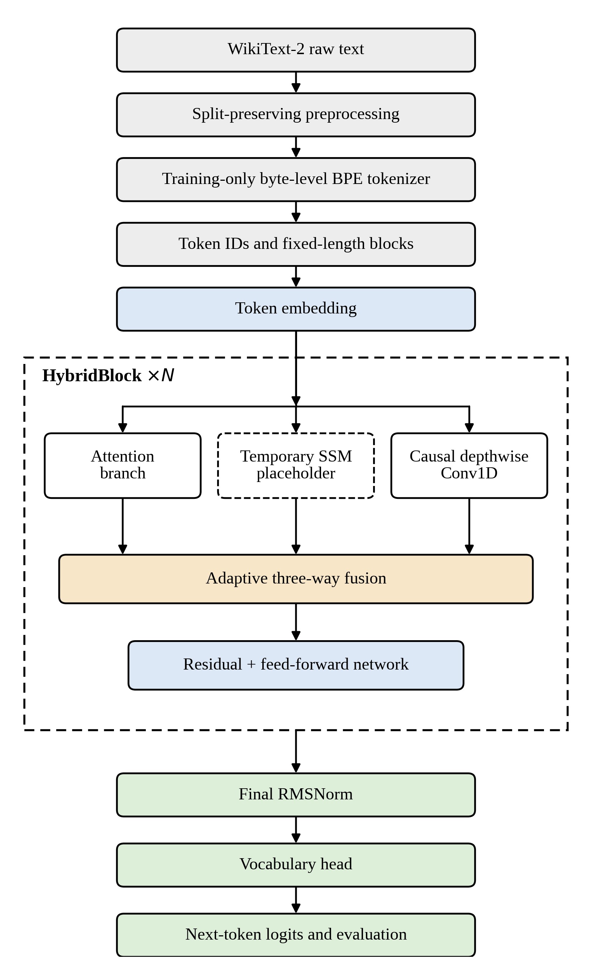
d. Proposed System Architecture
End-to-end language-model data flow
Training objective: predict token t+1 from tokens up to t. Causal attention masking and left-padded convolution prevent future-token leakage.
The model maps token IDs of shape [batch, sequence length] to logits shaped [batch, sequence length, vocabulary size]. For this run, the vocabulary is 10,000 and input length is 128. Each position produces a distribution over the next token when softmax is applied for prediction.
10

Slide 11
Inside a Hybrid Block
Normalization, parallel branches, fusion, residuals
Input + RMSNorm
Parallel branches
Adaptive gate
Residual + FFN
Normalized token features
Attention • placeholder • Conv1D
Per-token 3-way softmax
Second norm and feed-forward
Branch outputs: [B,T,d] • Gate tensor: [B,T,3]
The fused result is added to the residual stream, followed by a feed-forward transformation.
Known limitation: no explicit positional embedding or encoding is included.
11

Slide 12
e. Implementation Methodology
Training workflow
Prepare data
Configure
Train
WikiText-2 → tokenizer → tensors
Vocab 10k, dim 128, 4 blocks, 4 heads
AdamW, lr 3e-4, batch 4, 5 epochs
Validate
Checkpoint
Test
Cross-entropy and perplexity each epoch
Save lowest validation-loss model
Evaluate held-out test split
12

Slide 13
f. Expected Output — Training Results
Actual results from five epochs
Epoch | Train loss | Validation loss | Validation PPL | Seconds
1 | 6.1855 | 5.7073 | 301.06 | 518.1
2 | 5.3304 | 5.3448 | 209.51 | 530.0
3 | 4.9751 | 5.1888 | 179.25 | 601.1
4 | 4.7579 | 5.0871 | 161.92 | 414.1
5 | 4.5989 | 5.0354 | 153.76 | 418.4
Final train loss
Test loss
Test perplexity
4.5989
5.0349
153.68
13

Slide 14
Results: Interpretation
What the measurements establish
Learning observed
Validation improved
Preliminary only
Training loss decreased from 6.1855 to 4.5989.
Validation loss: 5.7073 → 5.0354; PPL: 301.06 → 153.76.
No claim of superiority over Transformer or Mamba is supported.
Summed epoch duration: 2,481.8 seconds (about 41 min 22 sec), excluding setup and final test evaluation.
Calculated parameter count: approximately 3,832,972. Peak memory and environment versions were not recorded.
14

Slide 15
Adaptive Gate Diagnostics
Mean gate weights from the run
Attention
0.3099
SSM placeholder
0.2292
Convolution
0.4609
Convolution received the largest mean weight in this run; this is descriptive, not proof of intrinsic superiority.
15

Slide 16
Expected Outputs and Deliverables
Files to preserve for reproducibility
Data artifacts
Training artifacts
tokenizer.json • train.pt • validation.pt • test.pt • metadata.json
training_history.csv • loss_curve.png • best_model.pt
Source files
Documentation
model.py • dataset.py • config.py • train.py • test_model.py
Dataset source • preprocessing • config • environment versions
Keep tokenizer, configuration, logs, and checkpoint together.
16

Slide 17
Limitations and Validity
Supported claims versus open issues
Known limitations
Claims supported now
• SSM is a temporary feed-forward placeholder
• No explicit positional encoding
• Small model; five epochs
• Standard multi-head attention, not GQA
• Peak memory and exact environment versions unavailable
• Public dataset pipeline ran
• Training and validation loss decreased
• Test evaluation completed
• Checkpoint, log, and plot generated
• Gate diagnostics recorded
Current results do not validate the final Attention–Mamba–Convolution architecture.
17

Slide 18
Next Steps
From prototype to defensible research
1. Reproducibility
2. Position information
3. Real SSM
Record software, hardware, and random seed
Add and test positional mechanism
Test Mamba independently before integration
4. Ablations
5. Efficiency
6. Reporting
Compare branches and fixed/adaptive fusion
Measure tokens/sec, latency, and memory
Keep data and evaluation protocols consistent
18

Slide 19
g. Technical References
Primary papers and official documentation
• Vaswani et al. (2017), Attention Is All You Need — arxiv.org/abs/1706.03762
• Gu, Goel & Ré (2022), Efficiently Modeling Long Sequences with Structured State Spaces — arxiv.org/abs/2111.00396
• Gu & Dao (2023), Mamba: Linear-Time Sequence Modeling with Selective State Spaces — arxiv.org/abs/2312.00752
• Lieber et al. (2024), Jamba: A Hybrid Transformer-Mamba Language Model — arxiv.org/abs/2403.19887
• Merity et al. (2016), Pointer Sentinel Mixture Models — arxiv.org/abs/1609.07843
• Dataset: huggingface.co/datasets/Salesforce/wikitext
• PyTorch MultiheadAttention and Hugging Face Tokenizers documentation
19

Slide 20
Conclusion
Summary of current status
Established
Still open
The prototype trained on real public text, completed held-out evaluation, and generated logs and a checkpoint.
Real SSM integration, positional handling, controlled baselines, and efficiency comparisons remain future work.
This is a successful preliminary pipeline experiment—not evidence that the final hybrid architecture outperforms existing models.
Thank you
20

